Slide 1
Walmart Hurricane Midterm Project
DS2002 Data Science Systems: Midterm Project
Xiangyu Shi and Simi Chakravarty

Slide 2
The mess
Walmart Transactions
30 duplicate rows
886 invalid timestamps
Inconsistent date formats
Fragmented SKUs
Inconsistent product names and categories
Price formatting and data type issues
Inconsistent store_id formats
Product Catalog
Fragmented SKUs
Inconsistent product names, categories
13 missing values in subcategory and 5 in unit_cost
Inconsistent package sizes
Supplier mismatches
DS2002 Data Science Systems: Midterm Project
Notes:
We cleaned all four CSV files: Walmart transactions, product catalog, store location, and distribution center. The biggest data quality issue we found was inconsistent SKUs, product names, and categories across both the Walmart Transactions and Product Catalog datasets. The same product could appear under different SKUs or names, which could lead to inaccurate sales calculations.
In the Walmart Transactions dataset, we also found 886 invalid timestamps and inconsistent date formats, which made it difficult to accurately compare sales across different periods. Other issues included 30 duplicate transaction rows, inconsistent store IDs, and price formatting problems.

Slide 3
The mess
Store Location
Inconsistent store_id formats
Inconsistent state abbreviations
zip_code stored as integer instead of string
Extra whitespace in region for 1 store (FL-619)
Duplicate stores with different IDs
1 missing value in latitude and 1 in longitude for FL-619
Distribution Center
surge_capacity stored as string instead of integer
1 missing value in cost_per_shipment
DS2002 Data Science Systems: Midterm Project
Notes:
For the Store Locations dataset, we found inconsistent store IDs, duplicate stores, formatting issues, and missing latitude and longitude values for one store.
For the Distribution Centers dataset, we found surge capacity stored as a string instead of an integer and one missing cost per shipment value.

Slide 4
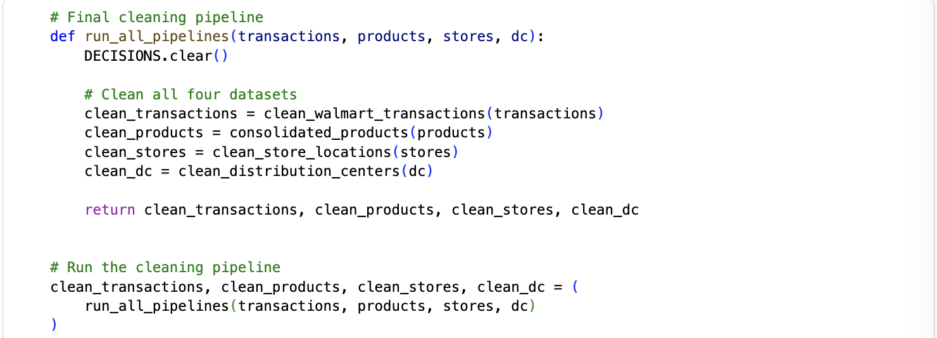
The pipeline
DS2002 Data Science Systems: Midterm Project
Notes:
We created a final cleaning pipeline that combines the cleaning functions for all four datasets. Instead of running each function separately, we can execute the entire cleaning process in one step and return all four cleaned datasets.

Slide 5
The pipeline: Cleaning Decision
Walmart Transactions
Removed 30 duplicate rows
Standardized timestamps and kept rows with missing dates (excluded later during analyses)
Created a date column containing only the date portion of timestamps
Converted unit_price from strings to floats
Removed rows with negative quantities (returns)
Standardized store_id to FL-# format
Consolidated fragmented SKUs
Standardized product names and categories
Product Catalog
Consolidated fragmented SKUs into canonical SKUs
Standardized product names, categories, and subcategories
Kept 5 rows with missing unit_cost and existing cost variations
Standardized suppliers and package sizes using SKU mapping
DS2002 Data Science Systems: Midterm Project
Notes:
For both datasets, we consolidated fragmented SKUs and standardized product names and categories to ensure accurate merging and sales calculations. One important decision made for the Walmart Transactions dataset was to keep rows with missing timestamps to preserve transaction information during data cleaning. We later excluded these rows from analyses that required dates.

Slide 6
The pipeline: Cleaning Decision
Store Location
Standardized store_id to FL-# format
Standardized state to FL
Converted zip_code to strings
Removed extra whitespace in region
Removed duplicate stores after standardizing IDs
Kept 1 row with missing latitude and longitude values to preserve store location information
Distribution Center
Removed ~ symbols and converted surge_capacity to integers
Kept 1 row with missing cost_per_shipment to preserve distribution center information
DS2002 Data Science Systems: Midterm Project
Notes:
For Store Locations, we standardized store IDs and state values to maintain consistency across datasets. For Distribution Centers, we converted surge capacity from strings to integers.
One important decision was to keep rows with missing latitude, longitude, or cost per shipment values, since we want to preserve other useful information.

Slide 7
The Findings
DS2002 Data Science Systems: Midterm Project

Slide 8
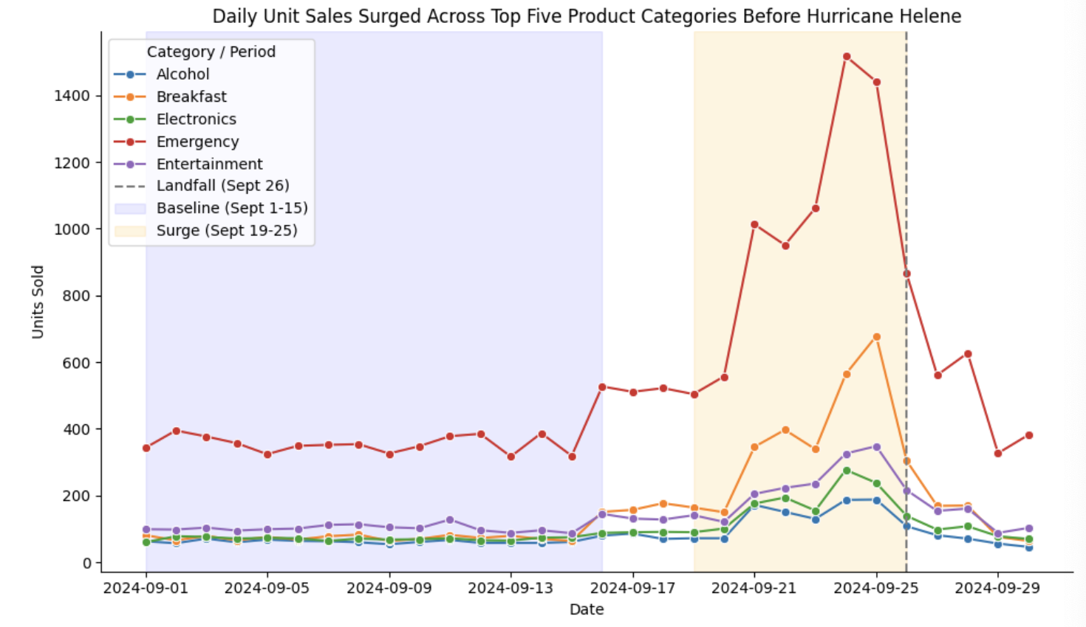
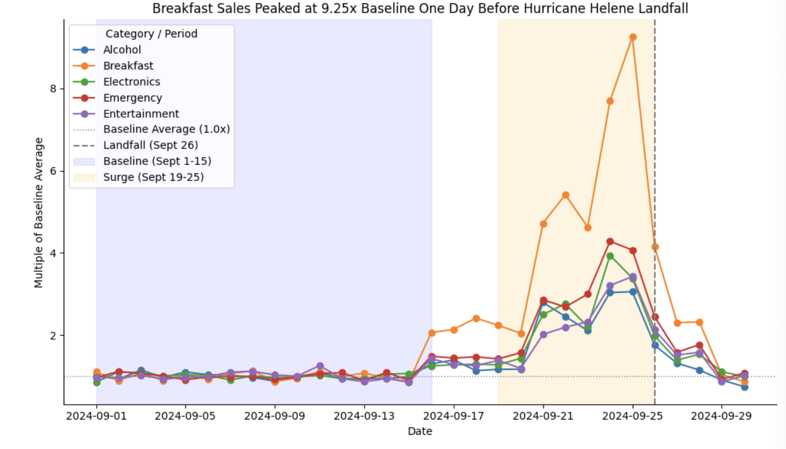
Question 1: Demand Surge Identification
Which product categories experienced the greatest sales surge in the 7 days before hurricane landfall compared to the prior baseline period? Quantify the percentage increase and visualize the daily trend for the top 5 categories.
DS2002 Data Science Systems: Midterm Project
Notes:
The hurricane landfall date is given as September 26, 2024. We chose September 1-15 as the baseline period to represent normal demand before hurricane. The surge period is defined as September 19-25, the seven days immediately before landfall.
In the graph on the left, we investigate the trends in absolute daily unit sales for the top five product categories throughout September 2024. Emergency had the highest daily unit sales among the five categories throughout the month. All five categories experienced an increase in daily unit sales during the surge period compared to the baseline period, with sales generally declining after Hurricane Helene made landfall on September 26.
the graph on the right shows the daily unit sales trends for the top five categories relative to their baseline averages. The horizontal reference line at 1.0x represents the baseline average, with values above 1.0x indicating sales higher than the baseline average and values below 1.0x indicating lower sales. Breakfast had the highest daily sales multiple among the five categories, reaching a peak of 9.25 times its baseline average on September 25, one day before Hurricane Helene made landfall.

Slide 9
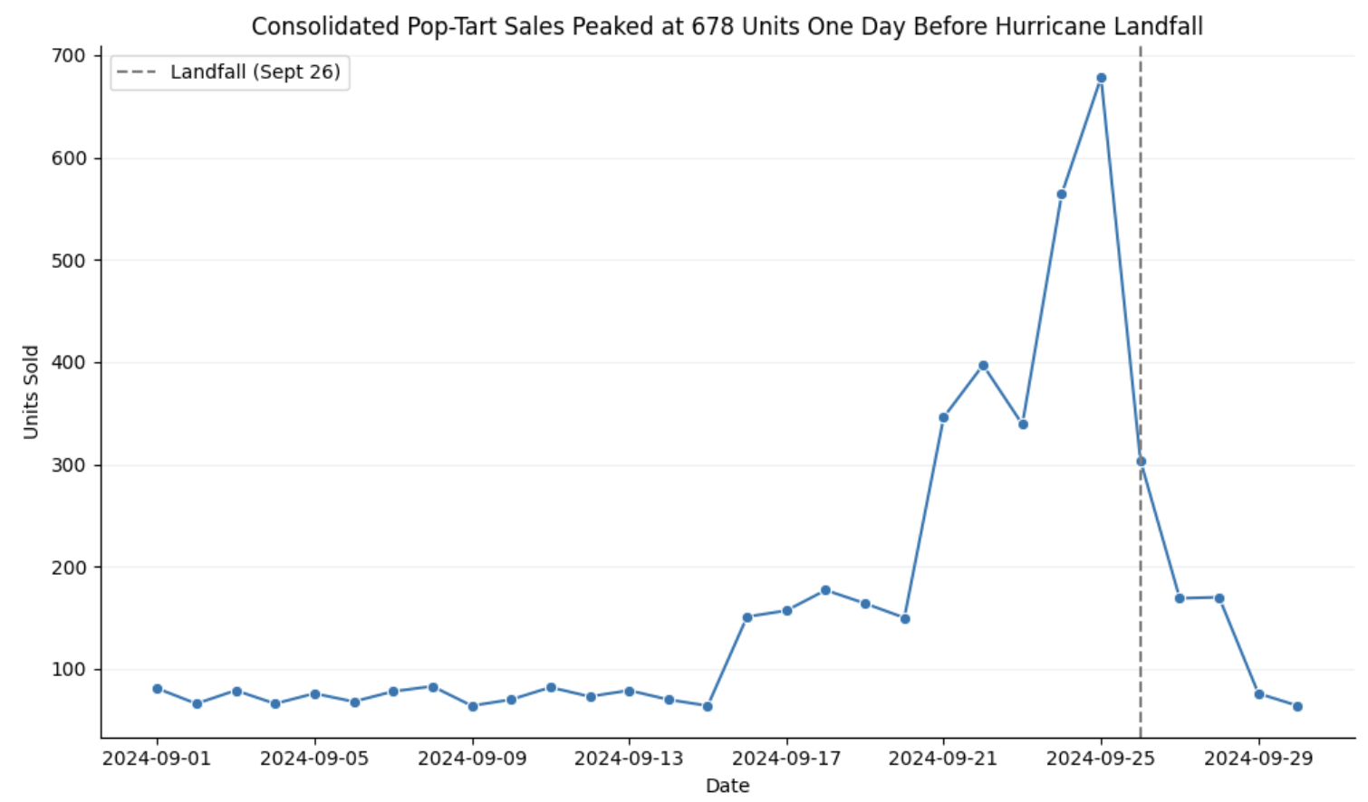
Question 2: The Pop-Tarts Effect (SKU Consolidation)
After standardizing all Pop-Tart SKU variants into a single product, what is the true daily sales volume? How does the uncleaned (fragmented) view compare to the cleaned (consolidated) view? What business decisions would differ between the two views?
DS2002 Data Science Systems: Midterm Project
Notes:
For this question, we investigate the true daily sales volume of Strawberry Pop-Tarts after consolidating all Pop-Tart SKU variants into a single standardized product. The dashed gray vertical line marks Hurricane Helene's landfall on September 26, 2024. Daily sales remained relatively stable during the baseline period, then increased significantly as the hurricane approached, reaching a peak of 678 units on September 25, one day before landfall. Sales decline sharply after landfall, showing a surge in demand for Strawberry Pop-Tarts ahead of the hurricane.

Slide 10
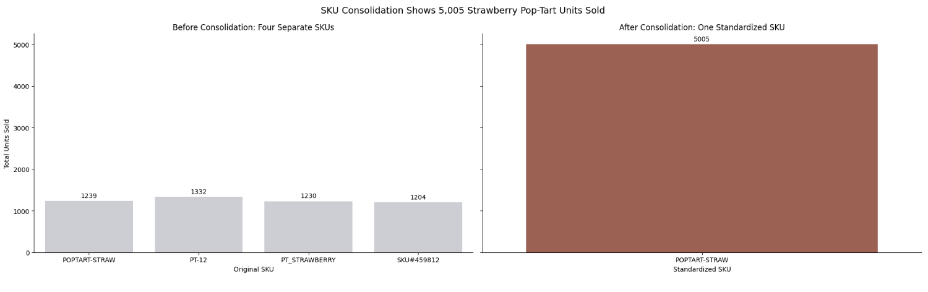
Question 2: The Pop-Tarts Effect (SKU Consolidation)
After standardizing all Pop-Tart SKU variants into a single product, what is the true daily sales volume? How does the uncleaned (fragmented) view compare to the cleaned (consolidated) view? What business decisions would differ between the two views?
DS2002 Data Science Systems: Midterm Project
Notes:
The side-by-side bar charts compare total Strawberry Pop-Tart units sold before and after SKU consolidation. Before consolidation, sales were fragmented across four SKUs (POPTART-STRAW, PT-12, PT_STRAWBERRY, and SKU#459812), each recording approximately 1,200-1,300 units. After consolidation, these four SKUs were combined into a single standardized SKU, POPTART-STRAW, showing a total of 5,005 units sold. This comparison demonstrates how inconsistent SKU naming can misrepresent the overall demand for a product by making one product appear as four different products.

Slide 11
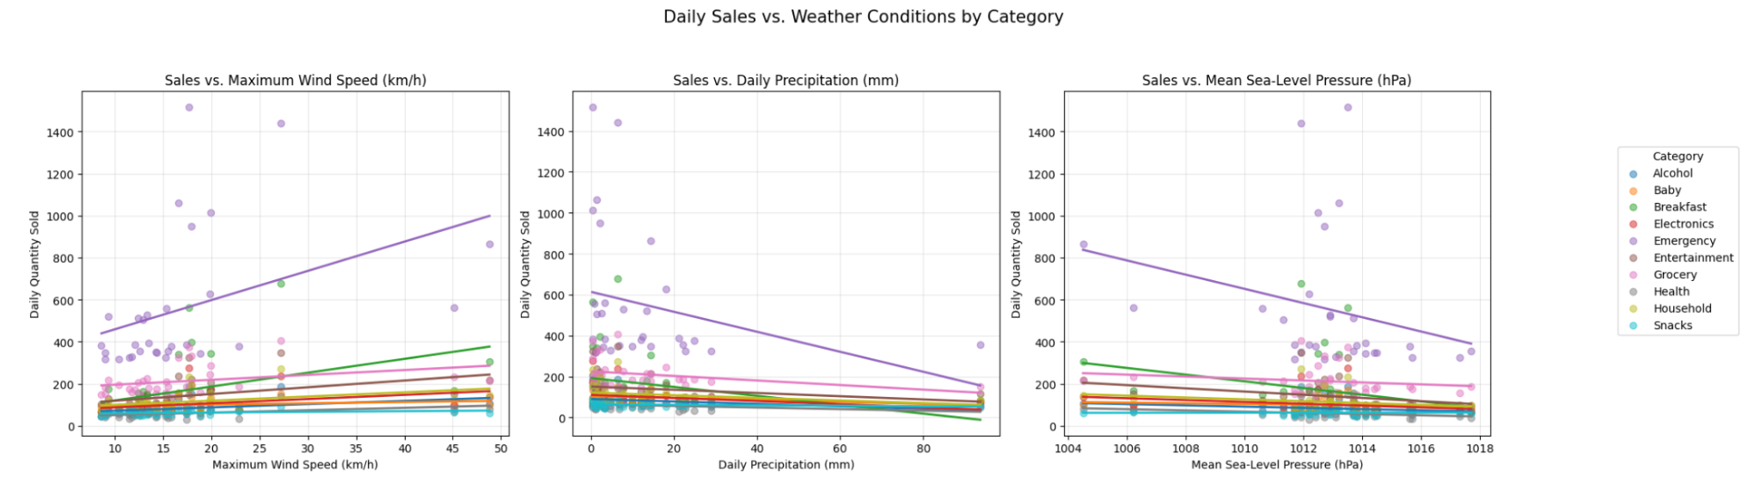
Question 3: Weather Correlation Analysis
Using weather data pulled from your chosen free API, how do specific weather indicators (wind speed, precipitation, barometric pressure) correlate with daily sales volume across categories? Is there a detectable lag between weather severity escalation and purchasing spikes?
DS2002 Data Science Systems: Midterm Project
Notes:
We first examined how daily sales correlated with weather indicators from our API, including maximum wind speed, precipitation, and barometric pressure (lower pressure corresponds to storm conditions). We observed a positive relationship between wind speed and sales, particularly in the Emergency category, while barometric pressure showed a negative relationship, suggesting that sales tended to increase as atmospheric pressure decreased and storm conditions intensified. Precipitation showed a less consistent relationship across categories, suggesting that wind speed and pressure may be more useful indicators of weather-related purchasing behavior.

Slide 12
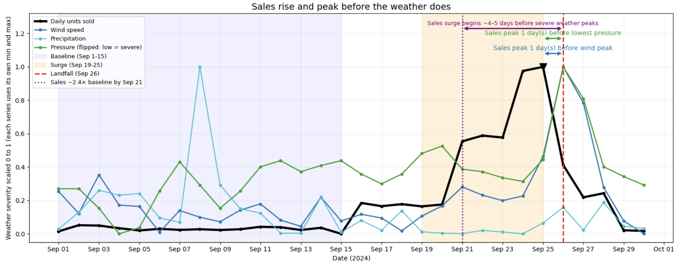
Question 3: Weather Correlation Analysis
DS2002 Data Science Systems: Midterm Project
Notes:
To investigate whether there was a detectable lag, we compared daily sales with weather severity leading up to Hurricane Helene's landfall on September 26th. Sales began surging (~2x baseline) around September 21st, approximately four to five days before peak weather severity, and peaked about one day before the lowest pressure and maximum wind speeds. This indicates that consumers were purchasing supplies in anticipation of the storm rather than waiting for severe weather to arrive.

Slide 13
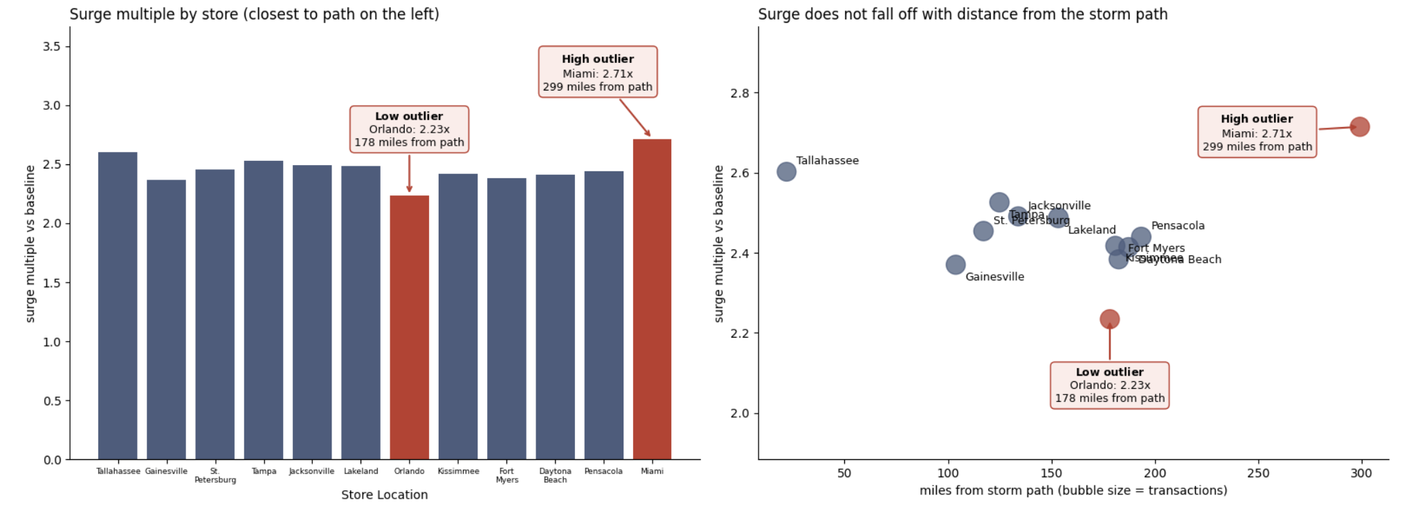
Question 4: Store-Level Geographic Patterns
Do all Florida store locations experience the same surge patterns, or do stores closer to the predicted hurricane path show earlier and larger spikes? Identify any stores that appear to be outliers.
DS2002 Data Science Systems: Midterm Project
Notes:
We next investigated whether stores closer to the predicted hurricane path experienced earlier or larger sales increases. Most locations experienced similar surges of approximately 2.4 to 2.6 times their baseline sales, suggesting that proximity alone did not determine demand. Miami was a high outlier at 2.71 times baseline despite being 299 miles from the storm path, while Orlando was a low outlier at 2.23 times baseline. However, there was a tight distribution of store sale surges, so these outliers may be artificial. Therefore, other regional factors likely influenced purchasing behavior."

Slide 14
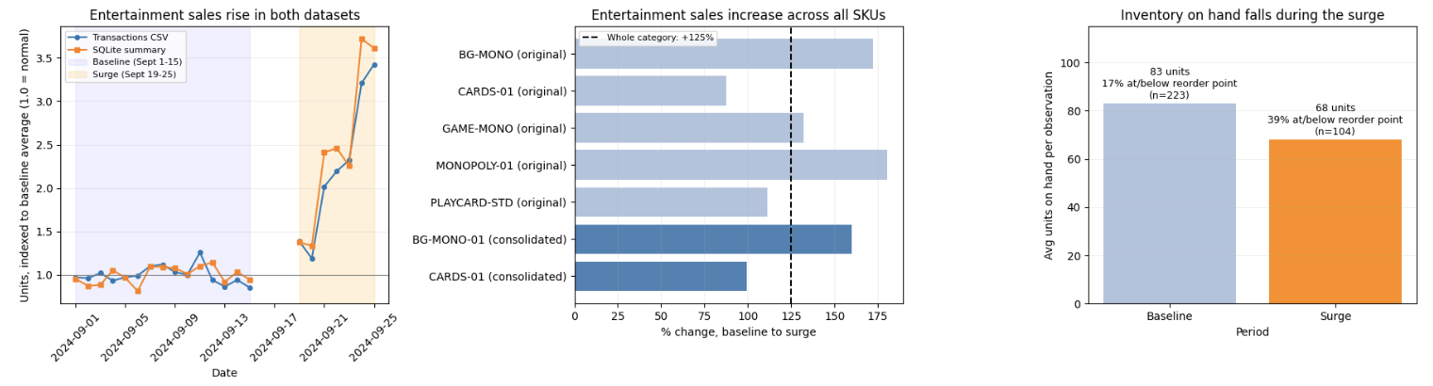
Question 5: Signal vs. Artifact — The Board Games Investigation
The board games/entertainment category shows a +250% sales increase. Using the SQLite inventory and sales database, investigate whether this is a genuine demand signal or a data artifact (e.g., SKU miscoding, category lumping, inventory reporting lag). Present your evidence and make a recommendation: should Walmart stock extra board games for the next storm?
DS2002 Data Science Systems: Midterm Project
Notes:
We investigated whether the reported Entertainment sales increase reflected genuine demand or a potential data artifact using our SQLite database. Both the transactions CSV and SQL summaries confirmed the increase, while SKU-level analysis showed that certain board games experienced sales lifts exceeding the category-wide 125% increase. However, not all products experienced the same demand. We also found that inventory observations at or below the reorder point increased from 17% to 39% during the surge. Based on this evidence, we recommend increasing stock for high-demand board game SKUs ahead of future storms.

Slide 15
Recommendation
Timing: Walmart should observe the weather forecast when deciding on stock, rather than looking at local weather, and have inventory in stores about a week before landfall. Demand rose days ahead of severe conditions (strongest link to wind and pressure at a two-day lag), peaked one day before landfall, and collapsed afterward.
Categories: Walmart should prioritize Breakfast and Emergency categories when preparing to stock for a hurricane.
Allocation: Walmart should apply a statewide multiplier of approximately 2.5x each store’s own baseline. Surge size and timing did not vary with distance from the storm path, so the location of store does not matter as much as the baseline sales.
Board Games/Entertainment: Walmart should add a modest increase of Board Games proportional to the 125-145% lift supported by the data (the CSVs and SQLite database), and not the 250% lift that was reported.
Data Cleaning: When trying to analyze data, Walmart should prioritize standardizing SKUs and categories at the source, rather than after data processing is required. For example, Pop-Tarts were split across 4 SKUs, when they could have easily been logged as a standard SKU, which would make data cleaning much easier.
DS2002 Data Science Systems: Midterm Project
Notes:
We have a couple of different recommendations based on the conditions that we observed. For timing of stocks, Walmart should consider the weather forecast rather than the intensity of current weather conditions, as sales tended to peak before the severe weather occurred. In particular, Breakfast and Emergency categories should be prioritized, as they showed the biggest increase during the Hurricane Helene surge periods. Since surge size and timing did not vary with distance from the surge path, it would make the most sense for Walmart to stock approximately 2.5x each store’s baseline for these categories. For Entertainment, we found that there was an increase in sales, but it was not as great as 250%. Because of this, we suggest that Walmart could modestly increase the Board Game stock. Finally, we also recommend that Walmart take some additional steps in their logs to make future data cleaning and analysis easier, such as standardizing SKUs at the individual store level so they are the same across the board.

Slide 16
What broke
In Q4, our first plan for measuring each store’s distance from Hurricane Helene’s path didn’t work because the store file had no coordinates for Tallahassee and the path we found online had only five forecast positions, each about a day apart, with longitudes on a 0 to 360 scale. In order to combat this issue, we learned to check which rows would be dropped and compare the units and coordinate systems of every source before joining. We handled it by filling in Tallahassee’s public coordinates and documenting the choice, converting the longitudes, and interpolating points along the path so that distance was measured to the whole line.
DS2002 Data Science Systems: Midterm Project
Notes:
We particularly had some issues with Q4 as we had some issues trying to find the hurricane path to measure store distance. The source that we originally found only had five forecast positions, so we had to check the cleaned store_locations dataframe to coordinate the correct distances. We also found that Tallahassee’s store locations were missing from the file, so we had to fill them in with publicly found coordinates of the store’s location.

Slide 17
Thank You!
DS2002 Data Science Systems: Midterm Project

